Slide 1
Introduction to data warehousing
MTN.BI.07
Partitioning
Elias Nema
Lead Software Engineer
Elias_Nema@epam.com

Slide 2
Agenda
Partitioning Overview
Partitioning Concept
Table Partitioning Schemes
Partitioning Indexes

Slide 3
Partitioning
Partitioning addresses key issues in supporting very large tables and indexes by decomposing them into smaller and more manageable pieces called partitions, which are entirely transparent to an application.
SQL queries and Data Manipulation Language (DML) statements do not need to be modified to access partitioned tables. However, after partitions are defined, Data Definition Language (DDL) statements can access and manipulate individual partitions rather than entire tables or indexes.

Slide 4
Logical and Physical Partitioning
Each partition of a table or index must have the same logical attributes, such as column names, data types, and constraints, but each partition can have separate physical attributes, such as compression enabled or disabled, physical storage settings, and tablespaces.

Slide 5
Is it useful?
OLTP systems often benefit from improvements in manageability and availability.
Data warehousing systems benefit from performance and manageability.

Slide 6
Benefits
It enables data management operations such as data loads, index creation and rebuilding, and backup and recovery at the partition level. This results in significantly reduced times for these operations.
It improves query performance. The results of a query can be achieved by accessing a subset of partitions and this technique (called partition pruning) can provide order-of-magnitude gains in performance.
It significantly reduces the impact of scheduled downtime for maintenance operations. Also it lets perform concurrent maintenance operations on different partitions of the same table or index.
It increases the availability of mission-critical databases.

Slide 7

Hooray, staying the same!
Partitioning can be implemented without requiring any modifications to your applications.

Slide 8
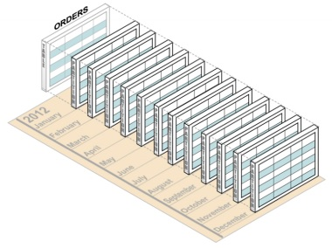
Overview

Slide 9
ILM and Partitioning
Information Lifecycle Management (ILM) is a set of processes and policies for managing data throughout its useful life.
One important component of an ILM strategy is determining the most appropriate and cost-effective medium for storing data at any point during its lifetime: newer data used in day-to-day operations is stored on the fastest, most highly-available storage tier, while older data which is accessed infrequently may be stored on a less expensive and less efficient storage tier. Older data may also be updated less frequently so it makes sense to compress and store the data as read-only.

Slide 10
Partitioning concept

Slide 11
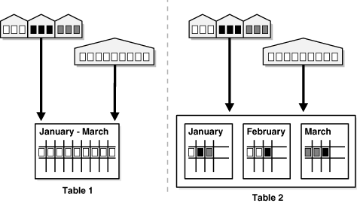
Partitioning Concept
From the perspective of a database administrator, a partitioned object has multiple pieces that can be managed either collectively or individually. This gives an administrator considerable flexibility in managing partitioned objects.
However, from the perspective of the application, a partitioned table is identical to a nonpartitioned table; no modifications are necessary when accessing a partitioned table using SQL queries and DML statements.

Slide 12
Partitioning Key
Each row in a partitioned table is unambiguously assigned to a single partition.
The partitioning key consists of one or more columns that determine the partition where each row is stored. Oracle automatically directs insert, update, and delete operations to the appropriate partition with the partitioning key.

Slide 13
Table Partitioning Schemes

Slide 14
When to Partition a Table
Tables that are greater than 2 GB.
These tables should always be considered as candidates for partitioning.
Tables that contain historical data, in which new data is added into the newest partition.
A typical example is a historical table where only the current month's data is updatable and the other 11 months are read only.
Tables whose contents must be distributed across different types of storage devices.

Slide 15
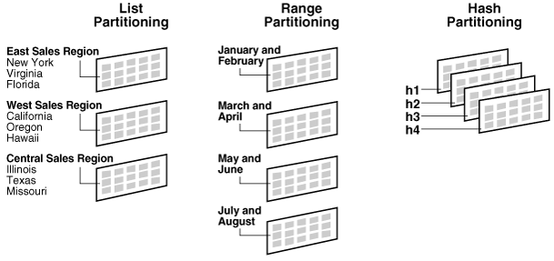
Strategies

Slide 16
Range Partitioning
CREATE TABLE range_example
( range_key_column date NOT NULL,
data varchar2(20))
PARTITION BY RANGE (range_key_column)
(
PARTITION part_1 VALUES LESS THAN (to_date('01/01/2010','dd/mm/yyyy')),
PARTITION part_2 VALUES LESS THAN (to_date('01/01/2011','dd/mm/yyyy'))
);
All partitions, except the first, have an implicit lower bound specified by the VALUES LESS THAN clause of the previous partition.
A MAXVALUE literal can be defined for the highest partition. MAXVALUE represents a virtual infinite value that sorts higher than any other possible value for the partitioning key, including the NULL value.

Slide 17
Hash Partitioning
CREATE TABLE hash_example
( hash_key_column date,
data varchar2(20) )
PARTITION BY HASH (hash_key_column)
(
partition part_1 tablespace p1,
partition part_2 tablespace p2
);
The hashing algorithm evenly distributes rows among partitions, giving partitions approximately the same size.
Hash partitioning is the ideal method for distributing data evenly across devices.

Slide 18
List Partitioning
CREATE TABLE list_example
( state_cd varchar2(2),
data varchar2(20) )
PARTITION BY LIST(state_cd)
(
PARTITION part_1 VALUES ( 'ME', 'NH', 'VT', 'MA' ),
PARTITION part_2 VALUES ( 'CT', 'RI', 'NY' )
);
The advantage of list partitioning is that you can group and organize unordered and unrelated sets of data in a natural way.
The DEFAULT partition enables you to avoid specifying all possible values for a list-partitioned table by using a default partition, so that all rows that do not map to any other partition do not generate an error.

Slide 19
Composite Partitioning
CREATE TABLE composite_example
( range_key_column date,
hash_key_column int,
data varchar2(20)
)
PARTITION BY RANGE (range_key_column)
subpartition by hash(hash_key_column) subpartitions 2
(PARTITION part_1 VALUES LESS THAN(to_date('01/01/2008', 'dd/mm/yyyy'))
(
subpartition part_1_sub_1,
subpartition part_1_sub_2
),
PARTITION part_2 VALUES LESS THAN(to_date('01/01/2011', 'dd/mm/yyyy'))
(
subpartition part_2_sub_1,
subpartition part_2_sub_2
)
);

Slide 20
Partitioning Indexes

Slide 21
When to Partition an Index
Avoid index maintenance when data is removed.
Perform maintenance on parts of the data without invalidating the entire index.
Reduce the effect of index skew caused by an index on a column with a monotonically increasing value.

Slide 22
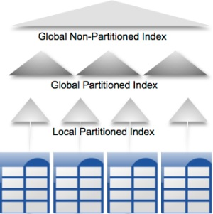
Indexes
In general, you should use global indexes for OLTP applications and local indexes for data warehousing or decision support systems (DSS) applications.

Slide 23
summary

Slide 24
Partitioning for Performance
Partition Pruning. Partition pruning is the simplest and also the most substantial means to improve performance using partitioning. Partition pruning can often improve query performance by several orders of magnitude.
Partition-Wise Joins. Partitioning can also improve the performance of multi-table joins by using a technique known as partition-wise joins. Partition-wise joins can be applied when two tables are being joined and both tables are partitioned on the join key.

Slide 25
Partitioning for Manageability
Partitioning enables you to partition tables and indexes into smaller, more manageable units, providing database administrators with the ability to pursue a divide and conquer approach to data management.
Rolling window is a typical load process in DWH.

Slide 26
Partitioning for Availability
Partitioned database objects provide partition independence. This characteristic of partition independence can be an important part of a high-availability strategy.
For example, if one partition of a partitioned table is unavailable, then all of the other partitions of the table remain online and available.

Slide 27
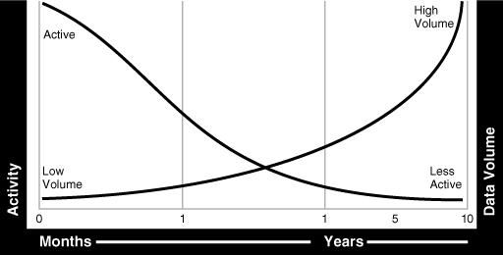
Data Usage Over Time

Slide 28
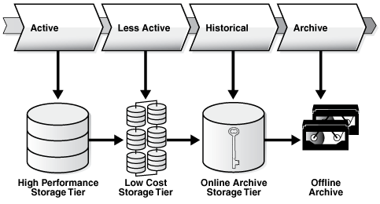
Money, that is it
One benefit of implementing an ILM strategy is the cost savings that can result from using multiple tiered storage. Assume that there is 3 TB of data to store, comprising of 200 GB on High Performance, 800 GB on Low Cost, and 2 TB on Online Archive. Assume the cost per GB is $72 on the High Performance tier, $14 on the Low Cost tier, and $7 on the Online Archive tier.

Slide 29
Hunting for profit
Storage Tier | Single Tier using High Performance Disks | Multiple Tiers with Database Compression
High Performance (200 GB) | $14,400 | $14,400
Low Cost (800 GB) | $57,600 | $11,200
Online Archive (2 TB) | $144,000 | $5,600
 | $216,000 | $31,200

Slide 30
Partitioning
Elias Nema
Lead Software Engineer
Elias_Nema@epam.com

